Slide 1
Time series forecasting

Slide 2
What is a time series?
Observations over time.
Examples include:
Temperature
Amount of traffic on street
Stock price

Slide 3
Interval between time
Regular | Irregular
1998-04-23 23°C 1998-04-24 24°C 1998-04-25 23°C 1998-04-26 25°C 1998-04-27 26°C 1998-04-28 25°C | 1998-04-23 3:00 23°C 1998-04-23 4:00 24°C 1998-04-23 4:12 23°C 1998-04-26 5:44 25°C 1998-04-27 9:48 26°C 1998-04-28 9:49 25°C
In time series analysis, converting data into a regular time interval is often necessary. This can be achieved using .resample() function from pandas.

Slide 4
Missing values
Temperature
1998-04-23 23°C 1998-04-24 24°C 1998-04-26 25°C 1998-04-27 26°C 1998-04-28 25°C | Day 1 Day 2 Day 4 Day 5 Day 6
In time series analysis, it is acceptable to have missing values. In case of missing values, we need to be cautious during the feature engineering stage.
In this example, we need to be aware that 26/4 is day 4 instead of day 3.
In case we want to fill null for 25/4, we may use .resample() and .interpolate() function from pandas.

Slide 5
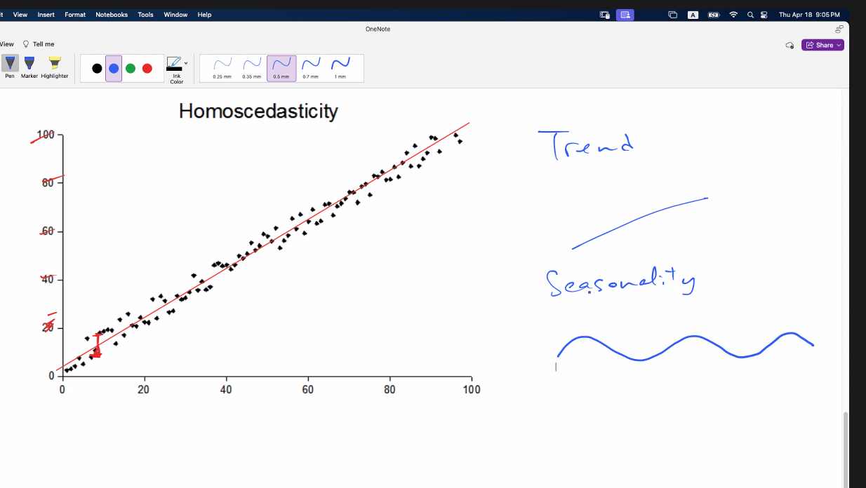
Modeling and prediction
Modeling: Explain the observations in the past
Prediction: Base on the explanation, predict the future
The difficulty of the prediction depends on
How much randomness exists in the time series
How many factors contributes to the observation
How do effects of the factors intervene each other
Examples:
(Easy) Elevator consumption per hour on working days
(Difficult) Bitcoin/usd price
Trend and seasonality may be not independent
The larger the trend, the larger the seasonlality , then the larger the error
Some factors need to multiply them together rather than adding them together

Slide 6
Predicting the next value in a time series is a regression task
Observations
Prediction

Slide 7
Recall: Regression model
 | Features
1975-11-03
1975-11-04
1975-11-05 | ?
1975-11-06
1975-11-07
Label
104
321
232
551
133
Recall that we need to prepare features (X) and label (y) for training a regression model. Now the question become - what is the X?

Slide 8
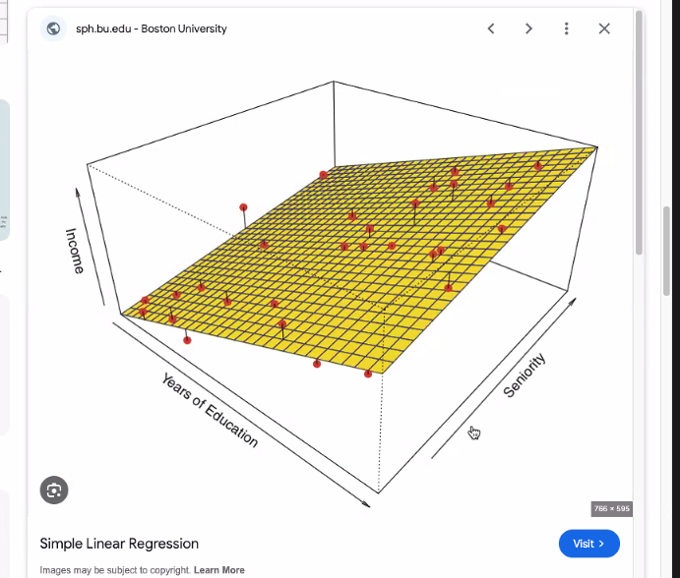
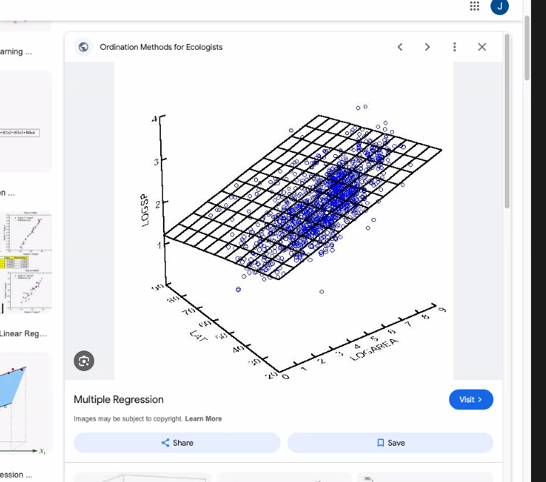
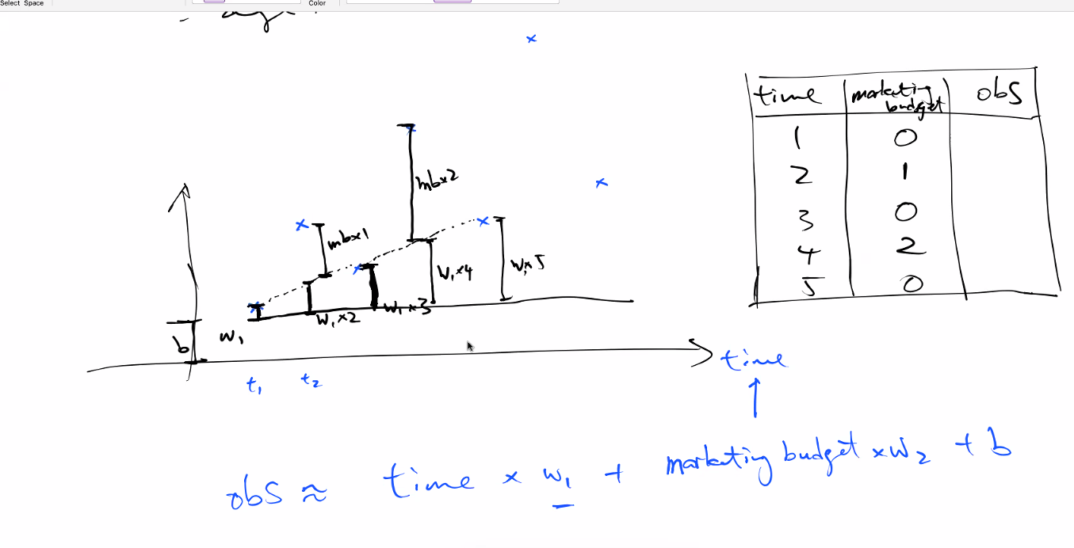
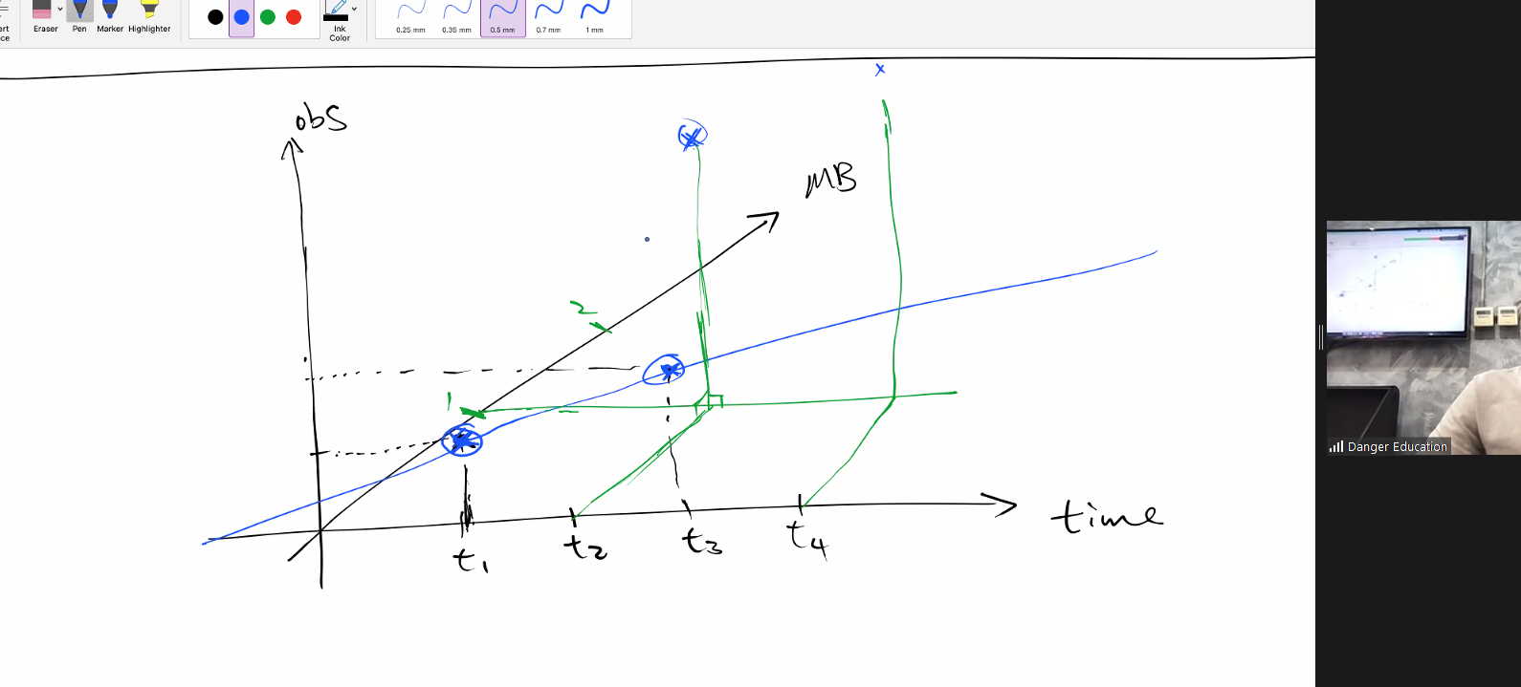
We add things linearly in the model. The points may be affected by other components as well.
If 3D, instead of best-fit line, we do best-fit sheet, so it’s still linear regression.
No matter it’s x,y,z, it’s only one way direction for each axis. Should not be bent!

Slide 9
Model evaluation

Slide 10
Evaluation - Mean Absolute Error (MAE)
Predicted
Actual
MAE is the average of all errors

Slide 11
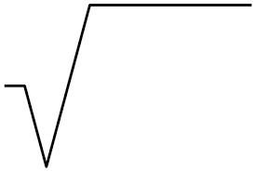
Evaluation - Root Mean Squared Error (RMSE)
Predicted
Actual
RMSE is the average of all squared errors
2
avg( )

Slide 12
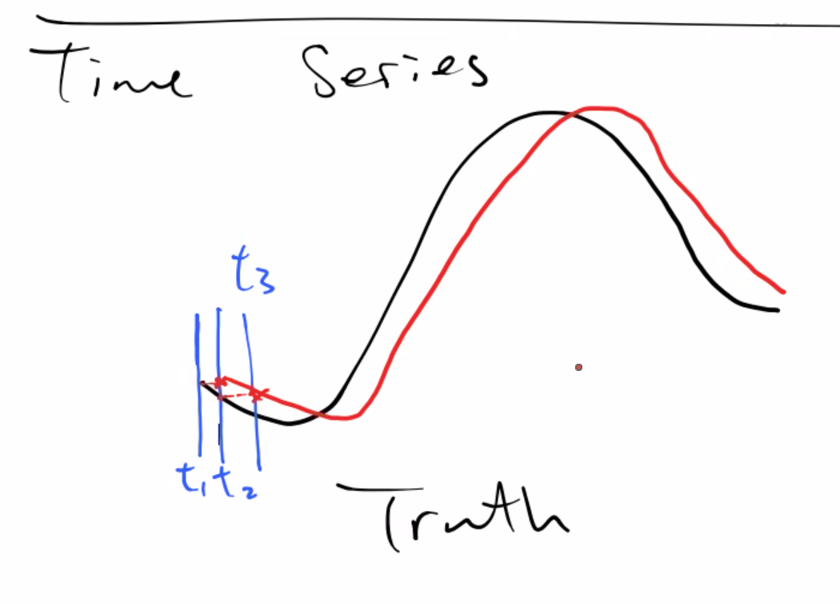
Evaluation - Mean Absolute Scaled Error (MASE)
We have to beat this approach. We have to beat this baseline model (one time lag)
MASE = MAE of real prediction / MAE of naive prediction
MASE is a measurement of how much better is our model compared to the naive model.
Naive Prediction - Predict with previous value
Real Prediction - Predict with model

Slide 13
MASE vs R²
Both MASE and R² compare the prediction with a baseline prediction.
In R², the baseline prediction is the average value of all labels. Applicable to general regression task.
In MASE, the baseline prediction is the previous value of the time series. Applicable to regression of time series.

Slide 14
Model time series

Slide 15
Popular ways to model TS
Traditional way
Auto Regressive
Moving Average
ARIMA
Modern way
Component decomposition
Linear regression
Tree based regression
Both streams will be discussed in upcoming lectures.

